Slide 1
AGILE AND SCRUM
“A Modern Approach to Software Development”
PRESENTED BY: RUBHASRI L

Slide 2
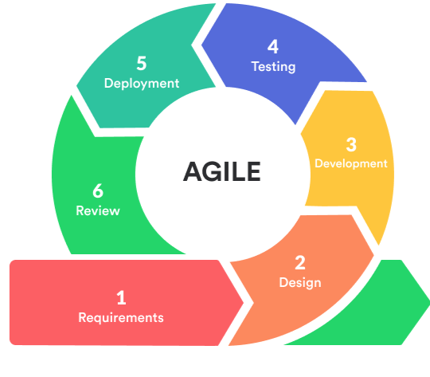
What is agile?
Agile is a flexible and iterative approach to software development.
Focuses on customer collaboration, adaptability, and continuous improvement.
Encourages small, incremental releases rather than one large release.

Slide 3
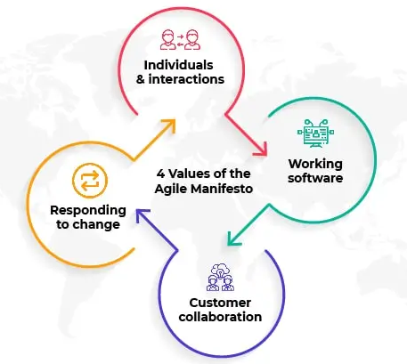
AGILE MANIFESTO
Four Core Values:
Individuals and interactions over processes and tools
Working software over comprehensive documentation
Customer collaboration over contract negotiation
Responding to change over following a plan

Slide 4
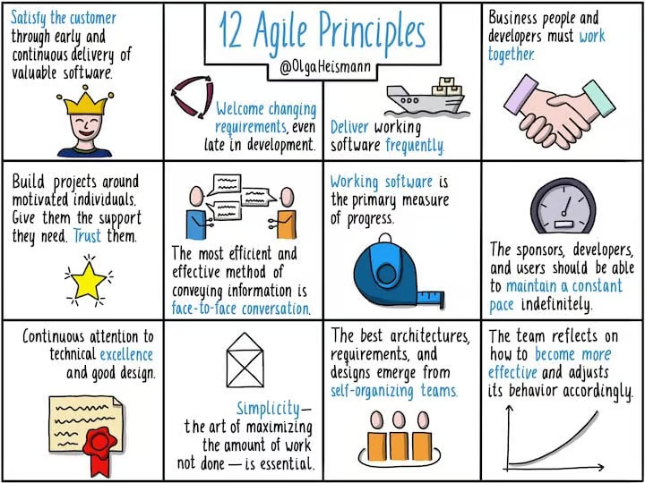
AGILE PRINCIPLES

Slide 5
What is SCRUM?
Scrum is a lightweight framework for managing work.
Based on Agile principles, focused on collaboration and iteration.
Uses fixed-length iterations (Sprints) to deliver working software

Slide 6
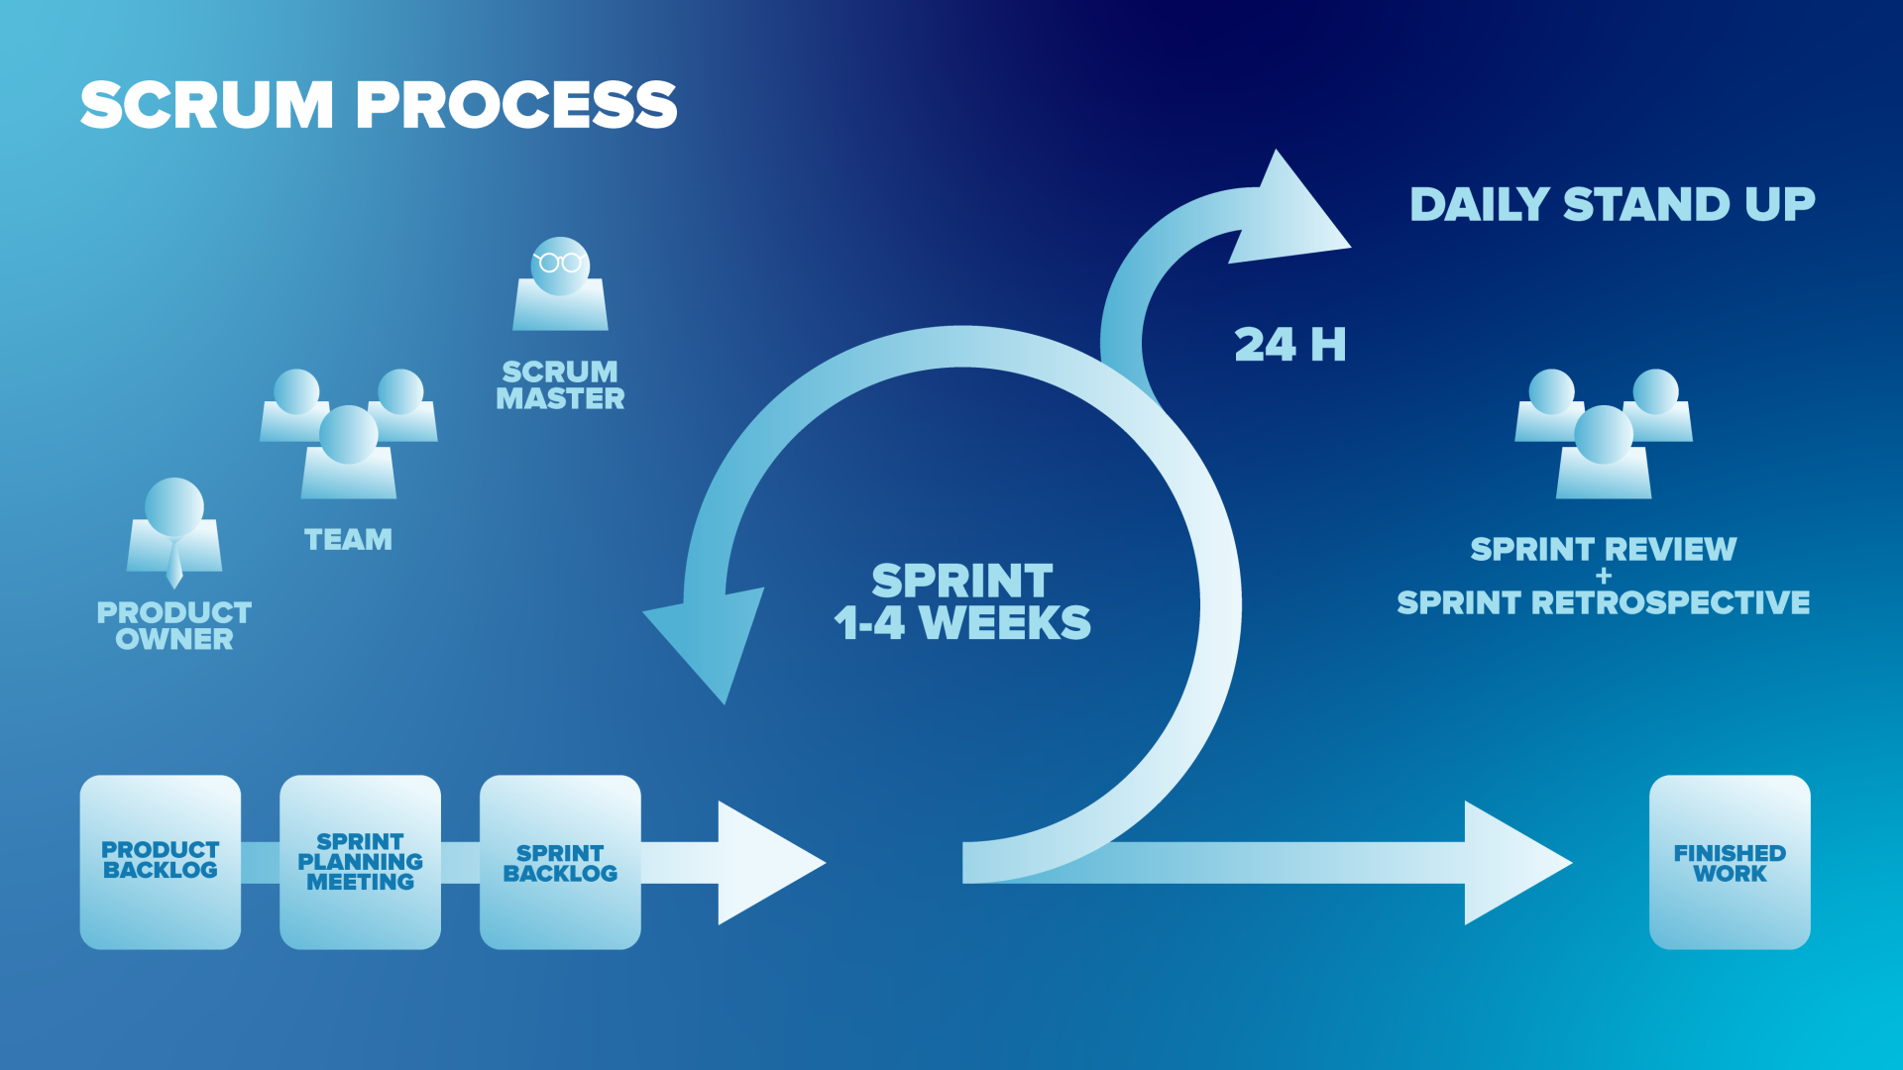

Slide 7
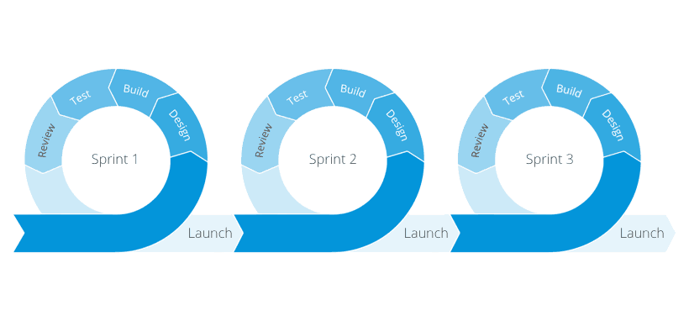
SPRINT
A sprint is a fixed time period where teams complete work from their product backlog.
Sprints are usually one, two, or four weeks long.

Slide 8
SCRUM FRAMEWORK
ROLES
Product Owner - Defines priorities and manages backlog
Scrum Master - Facilitates Scrum process, removes blockers
Development Team - Self-organizing team that delivers work
ARTIFACTS
Product Backlog - List of all desired work
Sprint Backlog - Selected items for the sprint
Burn Down Chart - Completed work at the end of the sprint

Slide 9
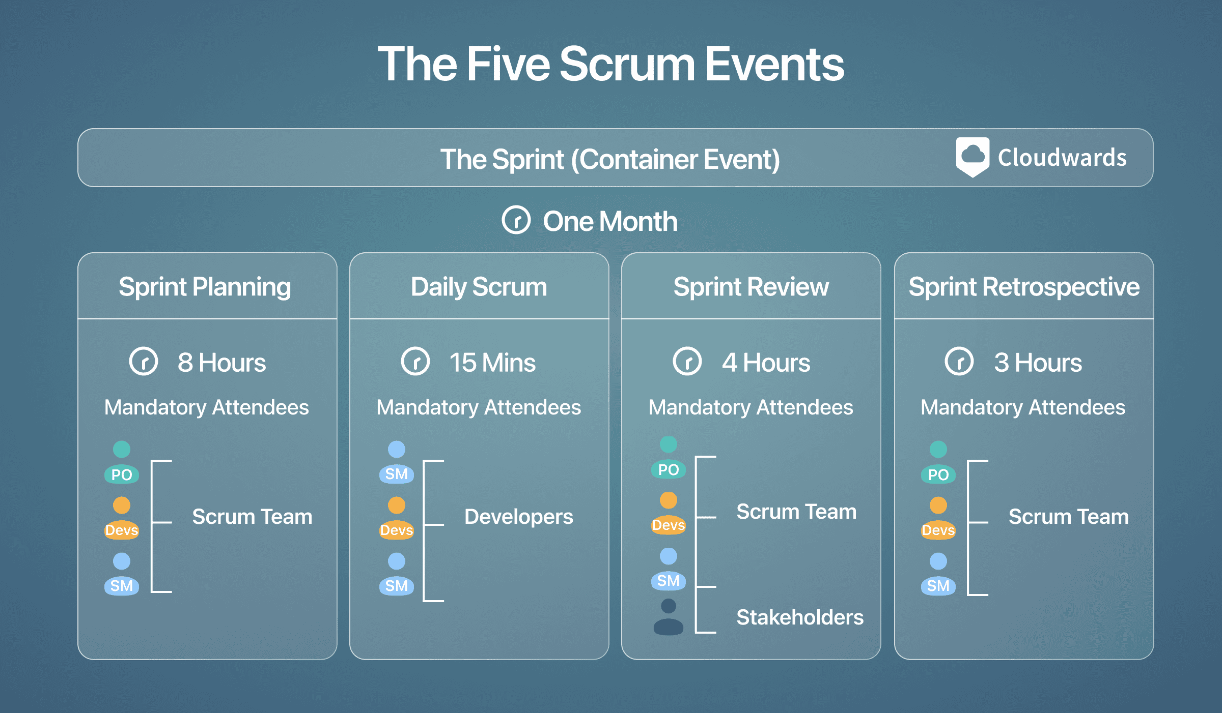
SCRUM EVENTS
Sprint Planning - Define work for the sprint
Daily Scrum Meeting - Short meeting to sync up
Sprint Review -Demonstrate completed work
Sprint Retrospective – Reflect and review

Slide 10

ANY QUESTIONS?

Slide 11
THANK YOU
“Agile is not a destination, but a journey of continuous improvement.”

